Slide 1

Capstone Project

Slide 2



Personal BACKGROUND
(Name, Past Experience, Qualification, Career Summary)
Name : Krishna Vamsi Gangisetty
Past Experience : Skilled in React, Node.js (MERN stack), FastAPI, large language models (LLMs), SQL, and MongoDB.
Qualification :BTech-CSE in Data Science
Career Summary : Enthusiastic fresher with a strong foundation in full-stack development using React, Node.js (MERN), FastAPI, and database management with SQL and MongoDB. Eager to leverage skills in modern technologies and contribute to innovative projects in a dynamic work environment.
www.collaberadigital.com

Slide 3


Key Takeaways/Learnings from the Program (HTD)
Different Types of Testing I learned about many kinds of testing like manual testing, automated testing, API testing, performance testing, and security testing.
Using Automation Tools I practiced writing automated test scripts using Selenium WebDriver with Java and TestNG. I also worked on API testing using Postman and Newman.
Performance Testing Basics I got to know how to use Apache JMeter to test how well an application performs, especially under load.
Test Planning and Tracking I learned how to write test cases, organize test suites, and track bugs using tools like JIRA and Xray.
Working with CI/CD I understood how automated tests fit into Continuous Integration pipelines, helping teams get quick feedback on code changes.
Writing Good Test Code I focused on writing clean and reusable test scripts, following patterns like the Page Object Model to keep code organized.
Real Project Experience I worked on a full test automation project from start to finish — designing tests, running them, and creating reports.

Slide 4

Problem Statement of the Capstone Project
The goal of this Capstone Project is to develop a comprehensive test automation suite covering web UI, API, and performance testing. The project requires creating automated Selenium tests for core functionalities like login and form submission using Java, TestNG, and the Page Object Model to ensure maintainability and scalability. Additionally, API testing must be implemented with Postman collections, validated through Newman CLI for status codes, response content, and performance. Performance testing should be conducted using Apache JMeter to simulate concurrent users and measure system responsiveness. The entire project must be integrated with GitHub for version control, following best practices with branches and CI builds. The main challenge is to design robust, reusable, and maintainable automated tests while effectively managing test execution and reporting across different tools.

Slide 5
Selenium Web UI Test Automation (Java + TestNG)
Framework: Implement the Page Object Model (POM) design pattern for maintainability.
Test Cases: Automate functional test cases such as login, form submission, and search functionality.
Logging: Integrate Log4j for logging test execution details.
Error Handling: Capture screenshots upon test failures for debugging.
Execution: Run tests using TestNG.xml or Maven commands (mvn test, mvn clean install).
Configuration: Support for headless or headed browser execution based on configuration files.
Cross-Browser Testing: Design tests to run on multiple browsers like Chrome and Edge.
Application Url: https://demoqa.com/

Slide 6
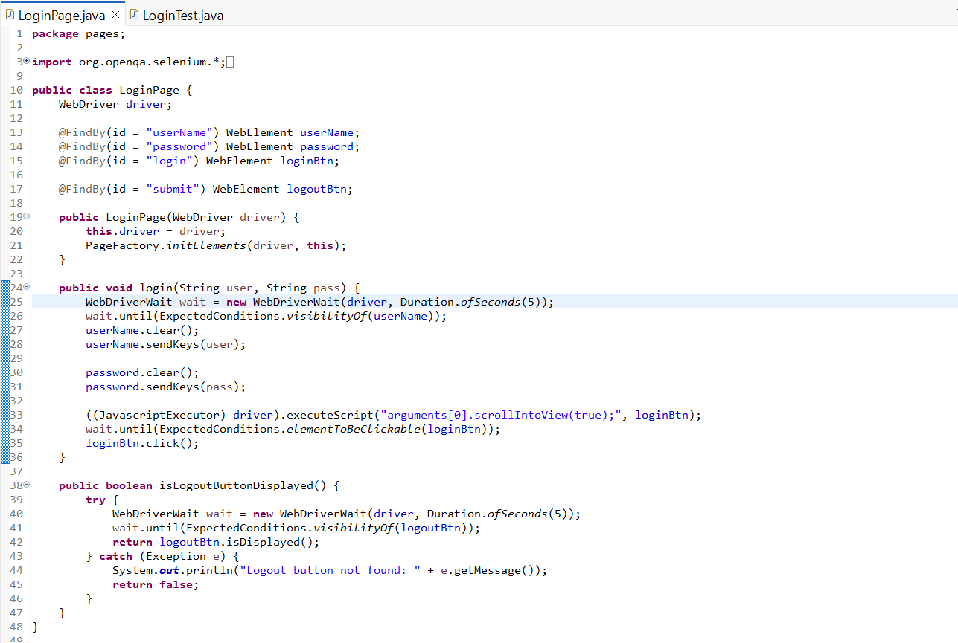
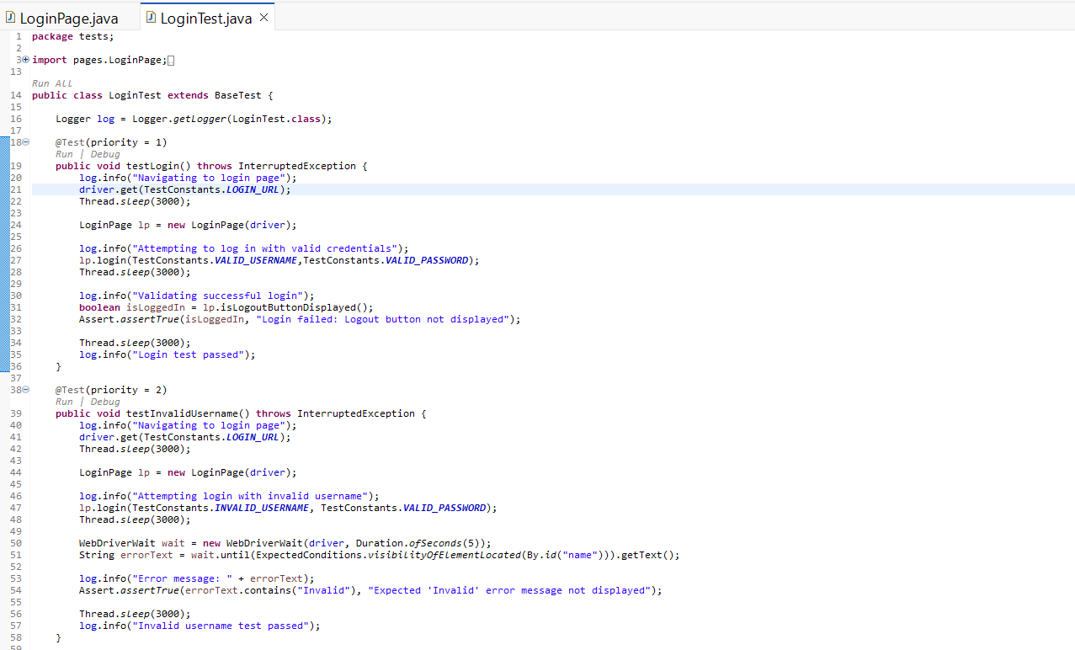
Screenshots

Slide 7
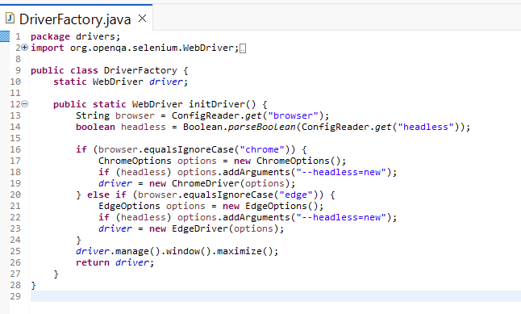
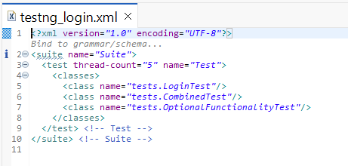
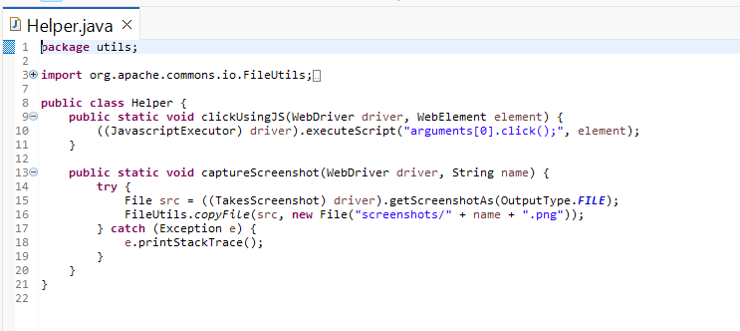

Screenshots

Slide 8
API Automation with Postman and Newman
API Testing: Design Postman collections to test APIs using methods like GET, POST, PUT, PATCH, and DELETE.
Assertions: Validate response status codes, body content, headers, and response times.
Automation: Export Postman collections and run them using Newman CLI for automated testing.
Reporting: Generate HTML reports using Newman reporters for detailed test results.
Application Url: https://api.restful-api.dev

Slide 9
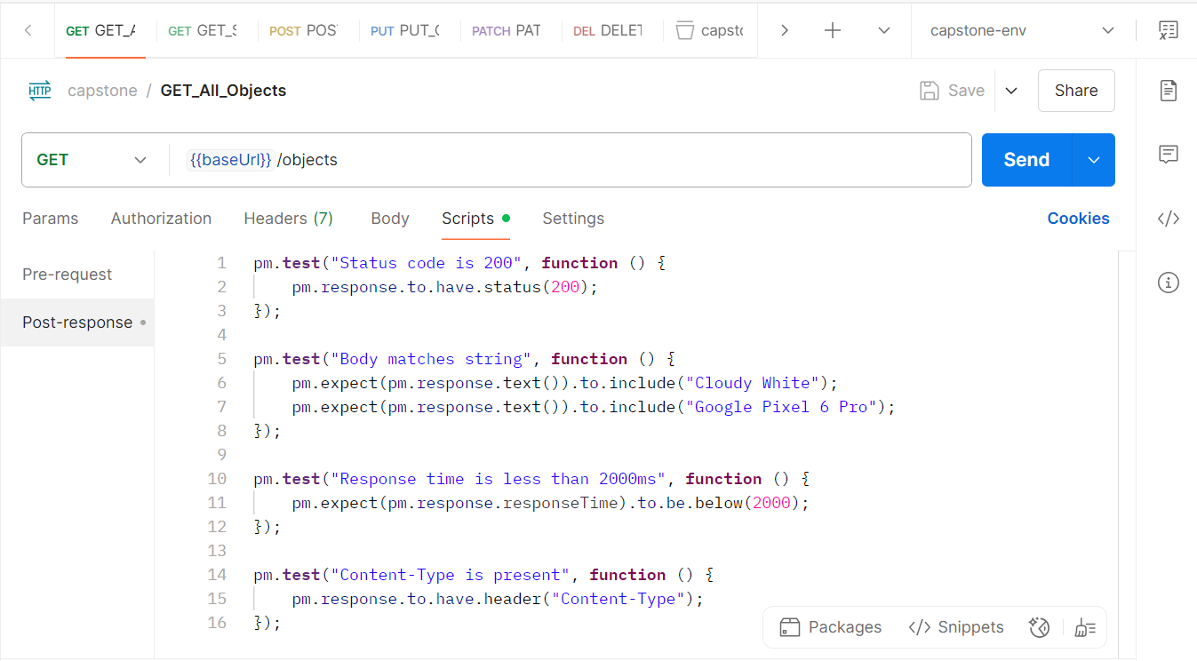
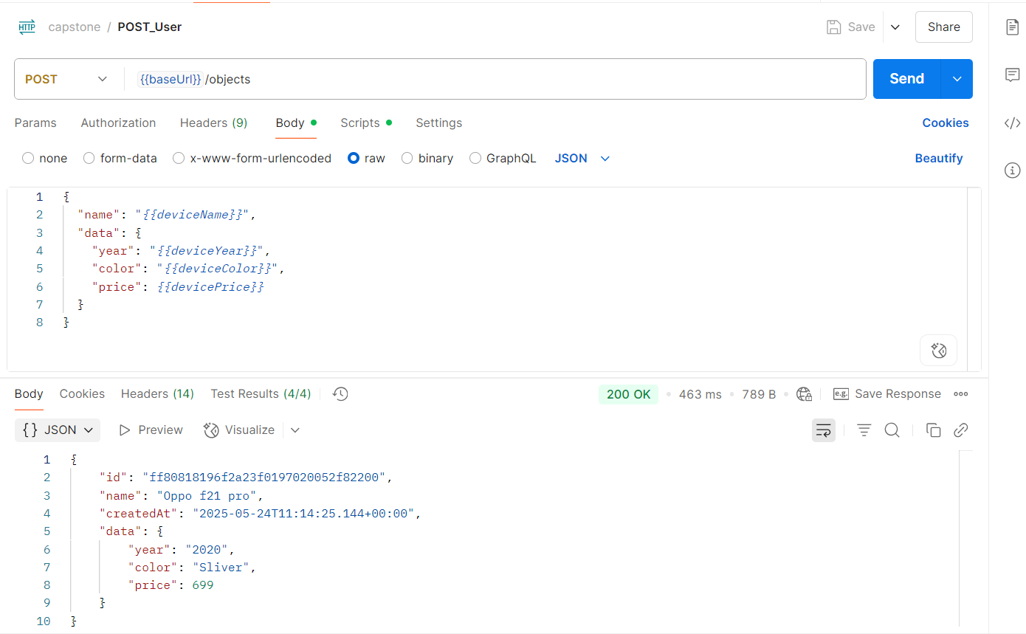
Screenshots

Slide 10
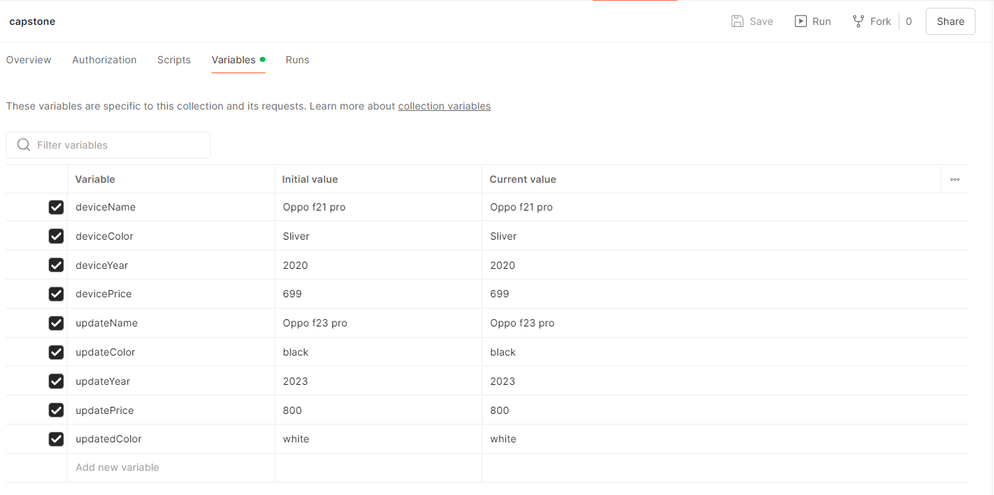
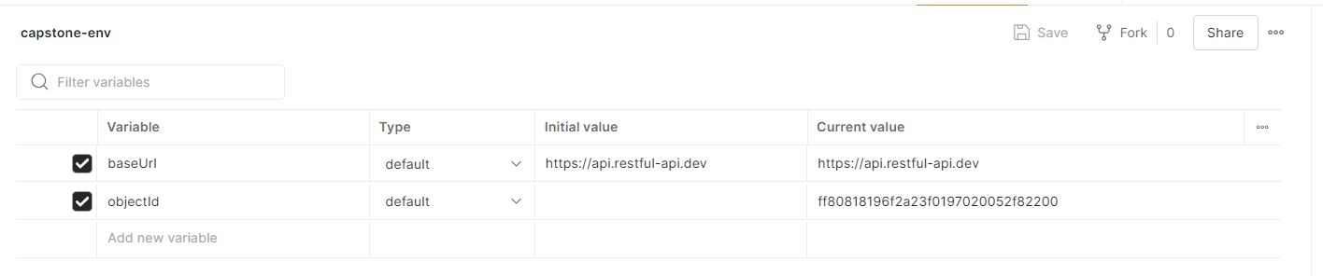
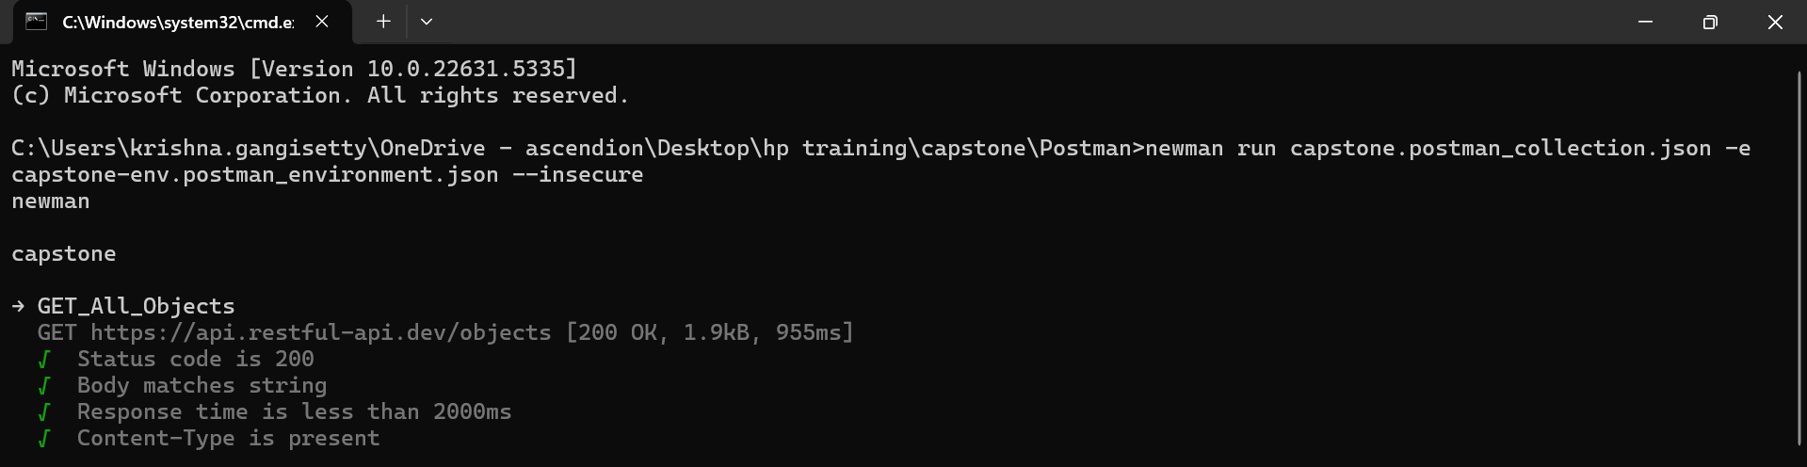
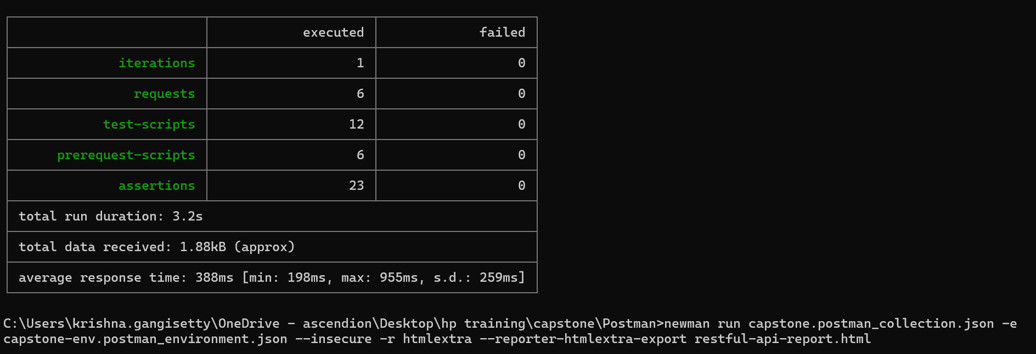
Screenshots

Slide 11
Performance Testing with JMeter
Test Plan: Create JMeter test plans to simulate concurrent users for API or web application performance testing.
Configuration: Set parameters like number of users, ramp-up time, and test duration.
Execution: Run JMeter tests from the command line and generate HTML reports.
Analysis: Analyze performance metrics such as response times, throughput, and error rates.
Application Url: https://api.restful-api.dev

Slide 12
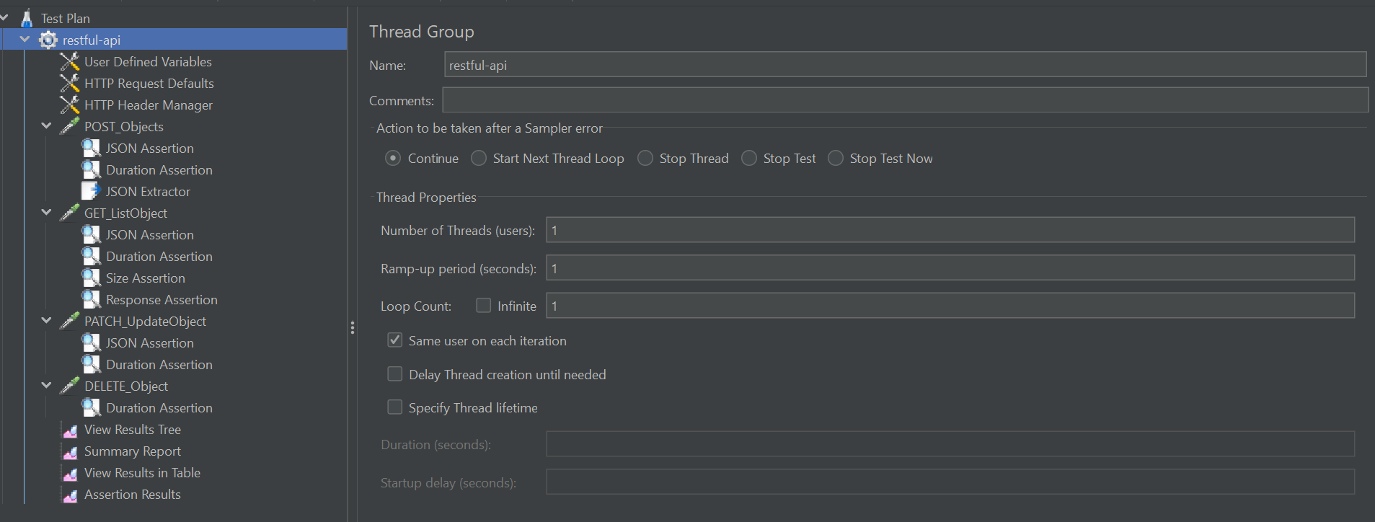
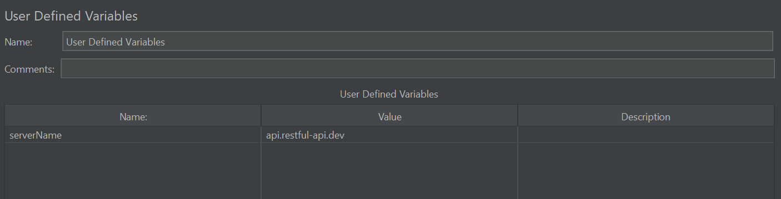
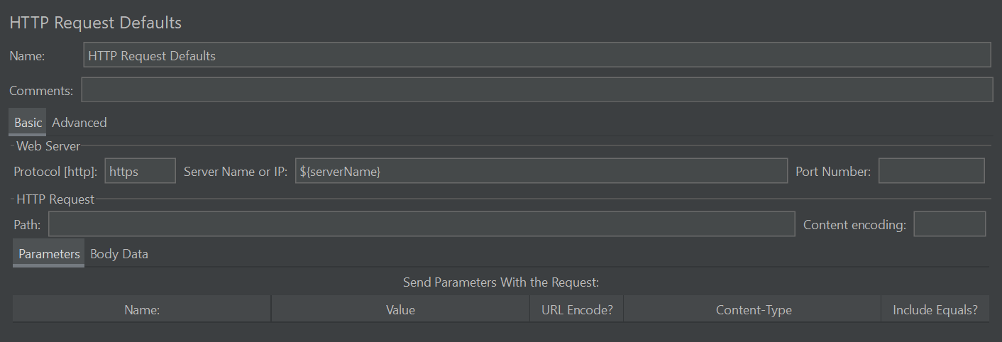
Screenshots

Slide 13
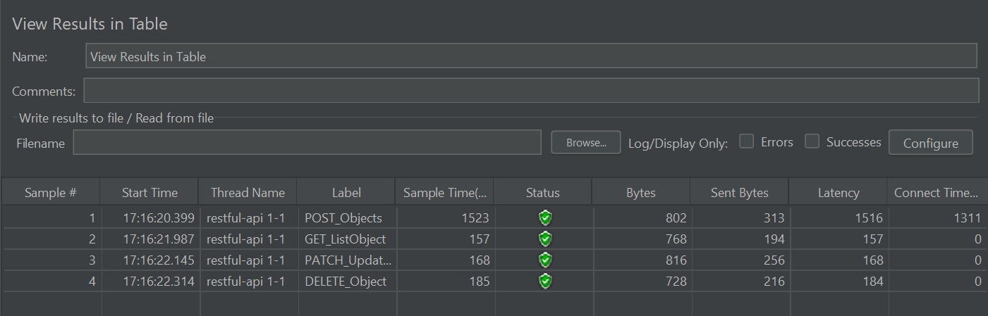
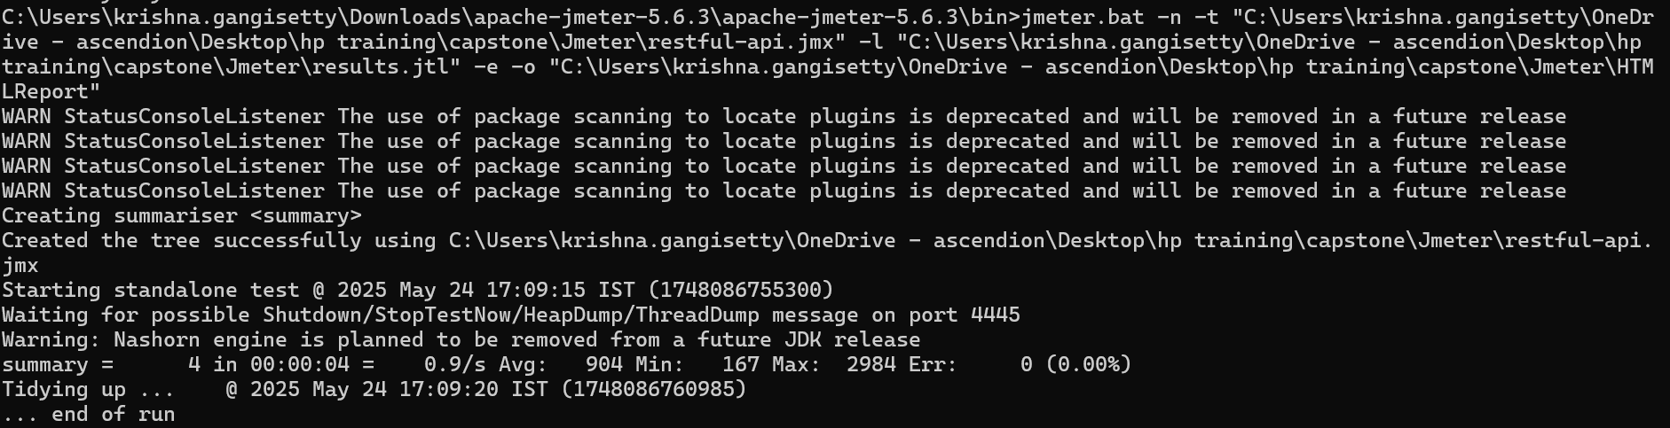
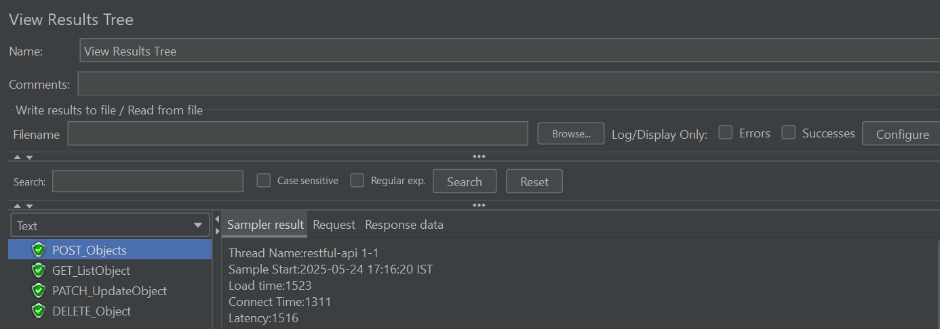
Screenshots

Slide 14
JIRA Integration & Test Management
Agile Planning: Organize work using Epics, User Stories, and Tasks. Break down large features into manageable pieces and assign them to appropriate team members.
Sprint Management: Plan and manage sprints by pulling prioritized items from the backlog, setting sprint goals, and tracking progress through burn-down charts.
Test Management: Utilize Xray plugins within JIRA to manage test cases, executions, and results.
Test Execution: Execute test cases directly from JIRA and monitor their progress.
Dashboard & Reporting: Customize dashboards to display real-time metrics like sprint velocity, issue status, test execution summary, and backlog health for better visibility and tracking.
Application Url: https://api.restful-api.dev

Slide 15
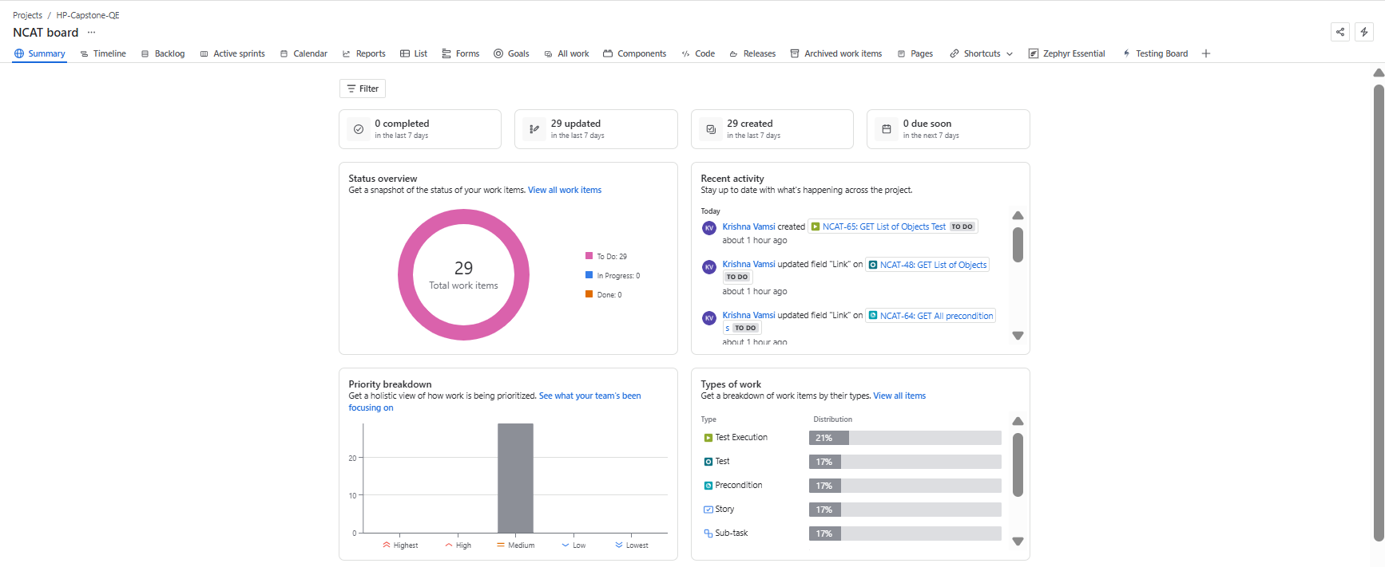
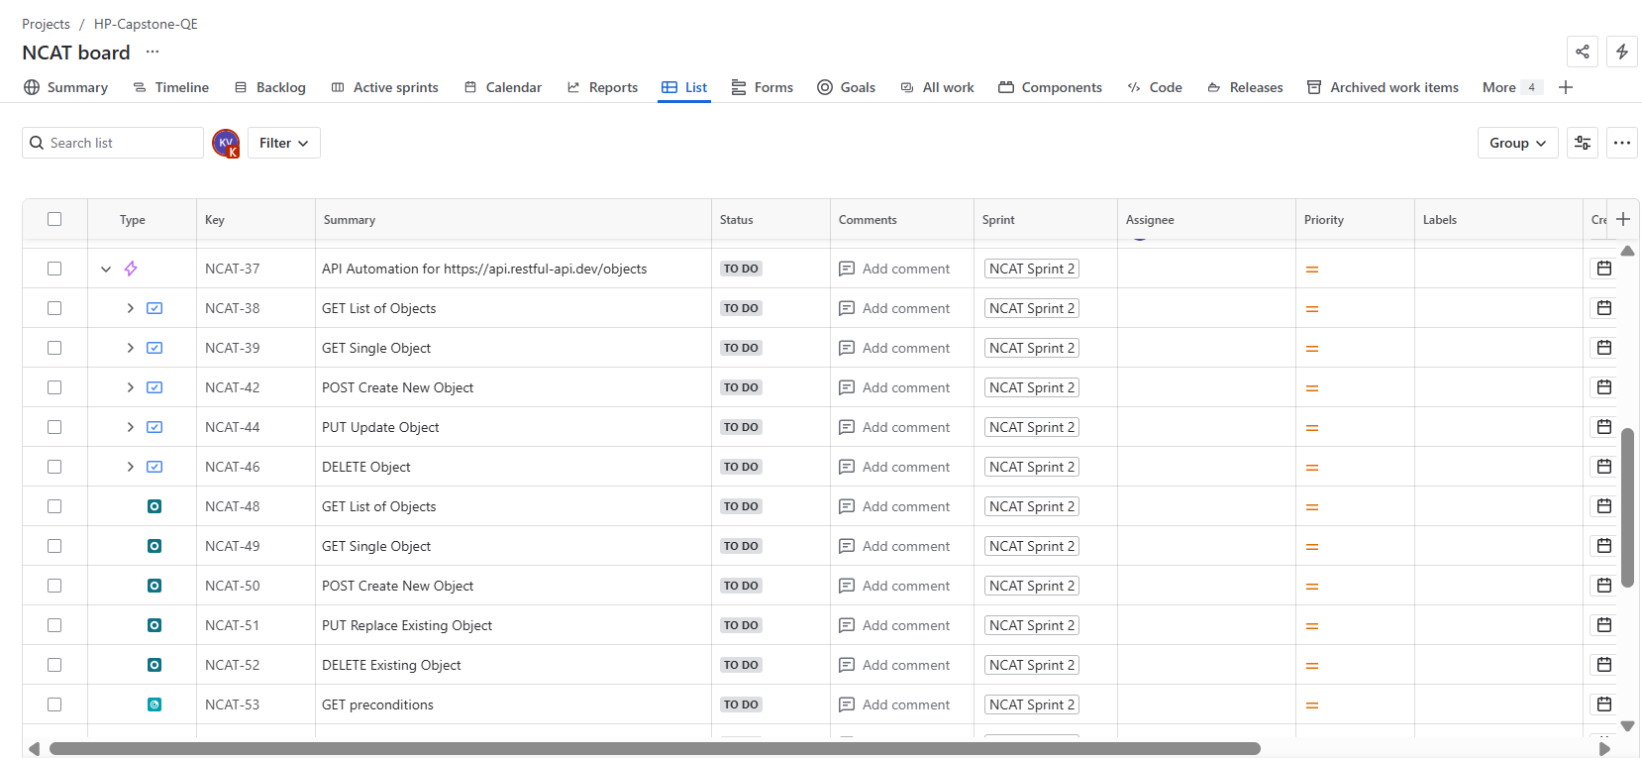
Screenshots

Slide 16
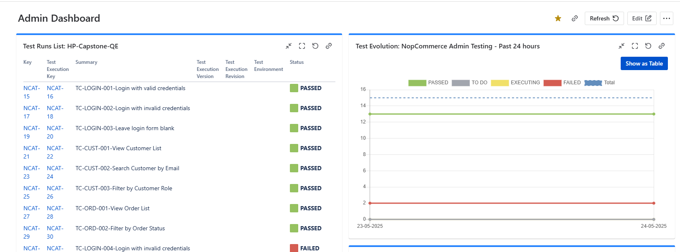
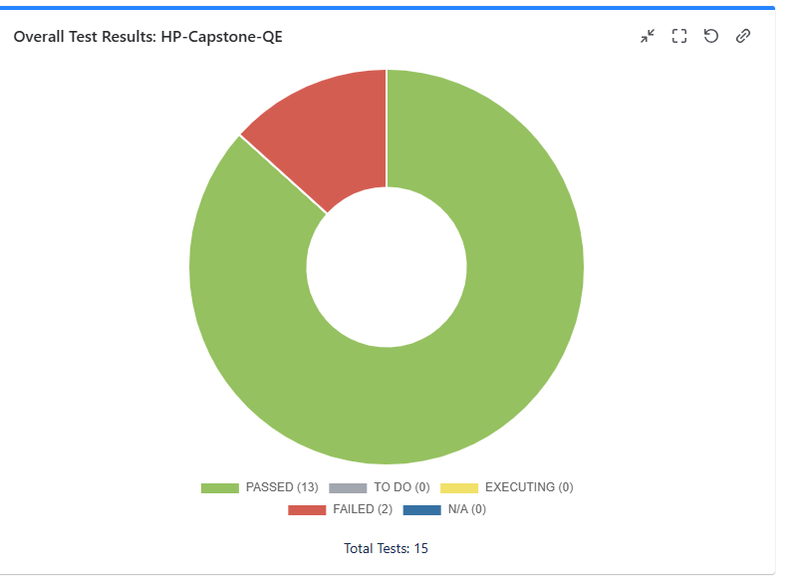
Screenshots

Slide 17
Conclusion
This capstone project successfully integrated end-to-end automation testing techniques, including Selenium Web UI, Postman API testing, and JMeter performance testing.
We implemented agile test management using JIRA with tools like Xray enabling real-time test planning, execution, and tracking.
The entire project was version-controlled and collaborated using GitHub, following best practices of CI/CD and branch management.
Through this project, we achieved comprehensive test coverage, ensured application stability and scalability, and demonstrated real-world QA practices.
This hands-on experience provided in-depth exposure to automation frameworks, performance testing, agile tools, and industry-standard workflows.

Slide 18
GITHUB URL:
https://github.com/krishna96182/CAPSTONE_COGNIXIA_WEB_API_MAY2025/tree/main

Slide 19
Thank You

